Slide 1
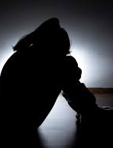
DEPPRESSIVE DISORDERS
Depressive disorders are the mood disorders that actually affects how you feel, think and behave and can lead to a variety of emotional and physical problems.
. It may trouble doing normal day-to-day activities, and sometimes you may feel as if life isn't worth living
Diagnosis of being depressed is determined by its duration, frequency and intensity.

Slide 2
Various types of depressive disorders according to DSM-5

Slide 3
Proposed DSM-5 Criteria for Major depressive disorder
Sad mood or loss of interest in usual activities ( Anhedonia)
At least 5 of the symptom( counting sad mood and loss of pleasure)
Sleeping too much or too little.
Psychomotor retardation or agitation
Weight loss or change in appetite
Loss of energy
Feelings of worthlessness or excessive guilt
Difficulty concentrating, thinking or making decision
Recurrent thoughts of death or suicide
Symptoms are present nearly everyday, most of the day, atleast for 2 weeks

Slide 4
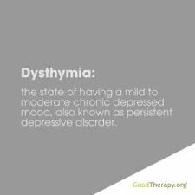
Proposed DSM-5 Criteria for Dysthemia
Depressed mood for most of the day more than half of the time for two years ( one year for children and adolescent)
at least two of the following during that time
poor appetite or overeating
sleeping too much or two little
low energy
poor self esteem
trouble concentrating or making decision
feeling of hopelessness
the symptoms do not clear for more than two months at a time.

Slide 5
Proposed DSM-5 Criteria for Premenstrual Dysphoric disorder
In most menstrual cycles during the past year , at least five of the following symptoms were present in the final week before menses and improved within a few days on the menses onset.
Affective lability
irritability
depressed mood, hopelessness, self- depreciating thoughts.
anxiety
diminish interest in usual activity
difficulty concentrating
lack of energy
change in appetite, overeating ,or food craving
sleeping too much or too little
subjective sense of being over -whelmed or out of control
physical symptoms such as breast tenderness, Or swelling , joint or muscle pain , or bloating .
Symptoms lead to significant distress or functional impairment
symptoms are not an exacerbation of another mood or anxiety disorder or a personality disorder
symptoms are confirmed with prospectus daily rating over 2 cycles
symptoms are present when oral contraceptives are not being taken.

Slide 6
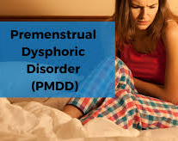
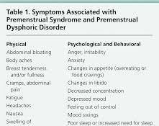

Slide 7
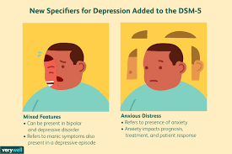
With Mixed Features : This specifier allows for the presence of manic symptoms as part of the depression diagnosis in patients who do not meet the full criteria for a manic episode.
With Anxious Distress The presence of anxiety in patients may affect prognosis, treatment options, and the patient’s response to them. Clinicians will need to assess whether or not the individual experiencing depression also presents with anxious distress.

Slide 8
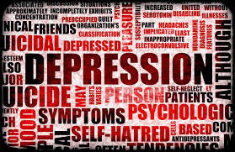
Epidemiology and consequences of Depression
Depression affects an estimated one in 15 adults (6.7%) in any given year.
One in six people (16.6%) will experience depression at some time in their life.
Women are more likely than men to experience depression.
a high degree of heritability (approximately 40%) when first-degree relatives (parents/children/siblings) have depression.

Slide 9
ETIOLOGY OF DEPRESSIVE DISORDER:
ABUSE; Past physical, sexual or emotional abuse can increase the chance of depression.
CONFLICT; Personal conflicts or dispute with family members or friend can lead to depression.
DEATH OR LOSE; Sadness and grief from the death or lose of love one may increase the risk of depression.
Genetics; a family history of depression may increase the depression.
major events; events like losing a job or income, getting divorced or retiring and any other stressful events can lead to depression.

Slide 10
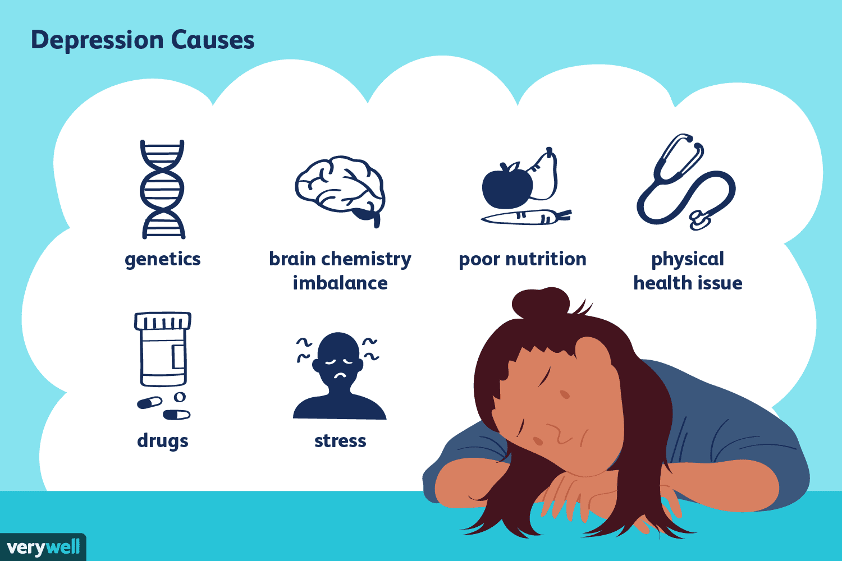
Substance abuse; the use of drugs or alcohol may also increase depression. Nearly 30% of people with substance abuse problem may have major or clinical depression.

Slide 11
Neurotransmitter; Researchers showed that there is a brain difference in the people of depression and normal people.
Small hippocampus-----fewer serotonin receptor
Serotonin is one of many brain chemical known as neurotransmitter that allows communications across circuit that connect different brain regions involve in processing.

Slide 12
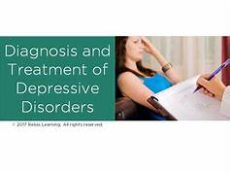
TREATMENT
MEDITATION
PSYCHOTHERAPY

Slide 13
MEDICATATION
antidepression medication
Selective serotonin reuptake inhibitors (SSRI); it works by helping inhibit the breakdown of serotonin in the brain, resulting in higher amount of this neurotransmitter

Slide 14
PSYCHOLOGICAL TREATMENT;
Interpersonal psychotherapy;
The core of the therapy is to examine major interpersonal problems.
It is a brief technique including discussing interpersonal problems, exploring negative feelings and encouraging their expression, problem solving and suggesting new and more satisfying moods of behaviour.

Slide 15
Cognitive therapy;
According to cognitive therapy, depression is caused by negative schemata and cognitive biases.
Change his/her opinion about self.
The therapist teaches a strategies to the client to identify thought patterns, to challenge negative beliefs and that promote making realistic and positive assumption.

